Slide 1

Prediction of cervical cancer ie7275: data mining in engineering project
By: TEAM8
Akshat Bhatia
Siddhant Jain
Prathmesh Mundhe
Vijay Nimbalkar

Slide 2



Introduction
Cervical cancer is a disease in which healthy cells on the surface of the cervix change, grow out of control, and form a mass of cells called a tumor.
This year, an estimated 12,820 women in the United States will be diagnosed with cervical cancer.
It is estimated that 4,210 deaths from the disease will occur this year.
The 5-year survival rate for all women with cervical cancer is 68%.
Doing this Project as interested in Health Sciences and Industry.

Slide 3
Problem Statement
In this project, we'll be analyzing data on Cervical Cancer cases in Venezuela and trying to find patterns in the dataset about the various attributes of the affected population and predict the outcome for a similar case.

Slide 4

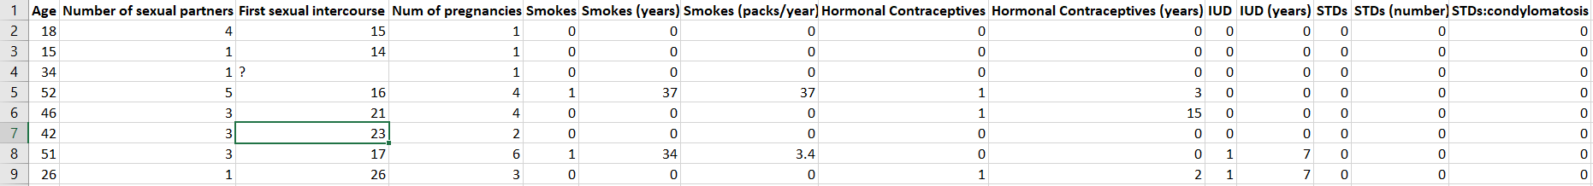
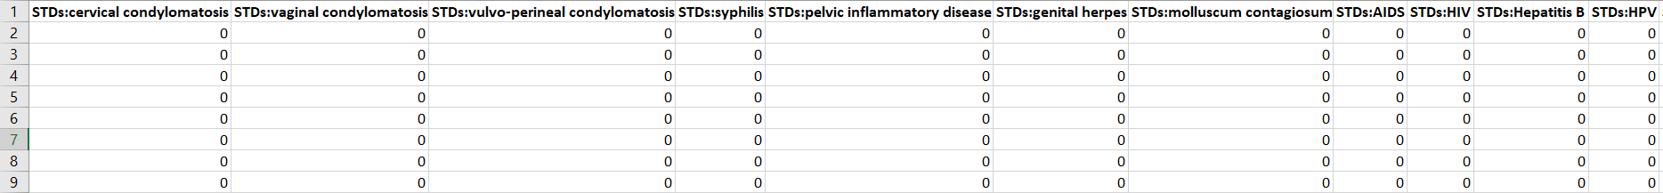
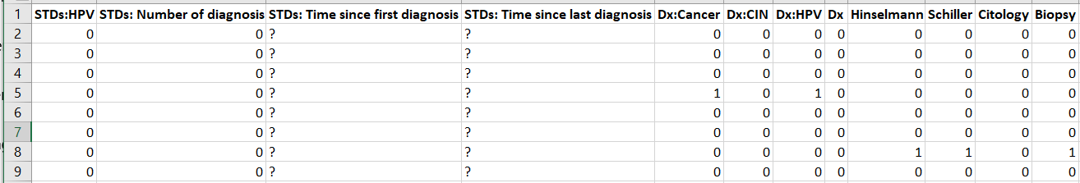
Data Set
32 Features and 4 Outcomes of 858 patients
Features like: Age, Number of sexual partner, First sexual intercourse, Smokes etc.
Outcomes: Hinselmann, Schiller, Citology & Biopsy
First few rows of each features and outcomes
Notes:
? marks

Slide 5
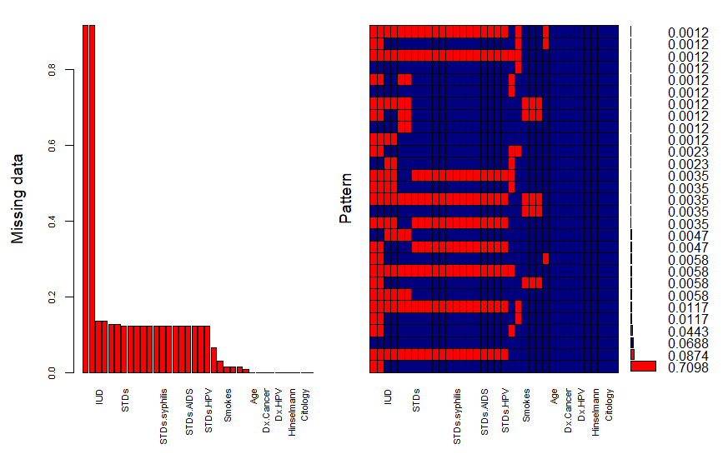
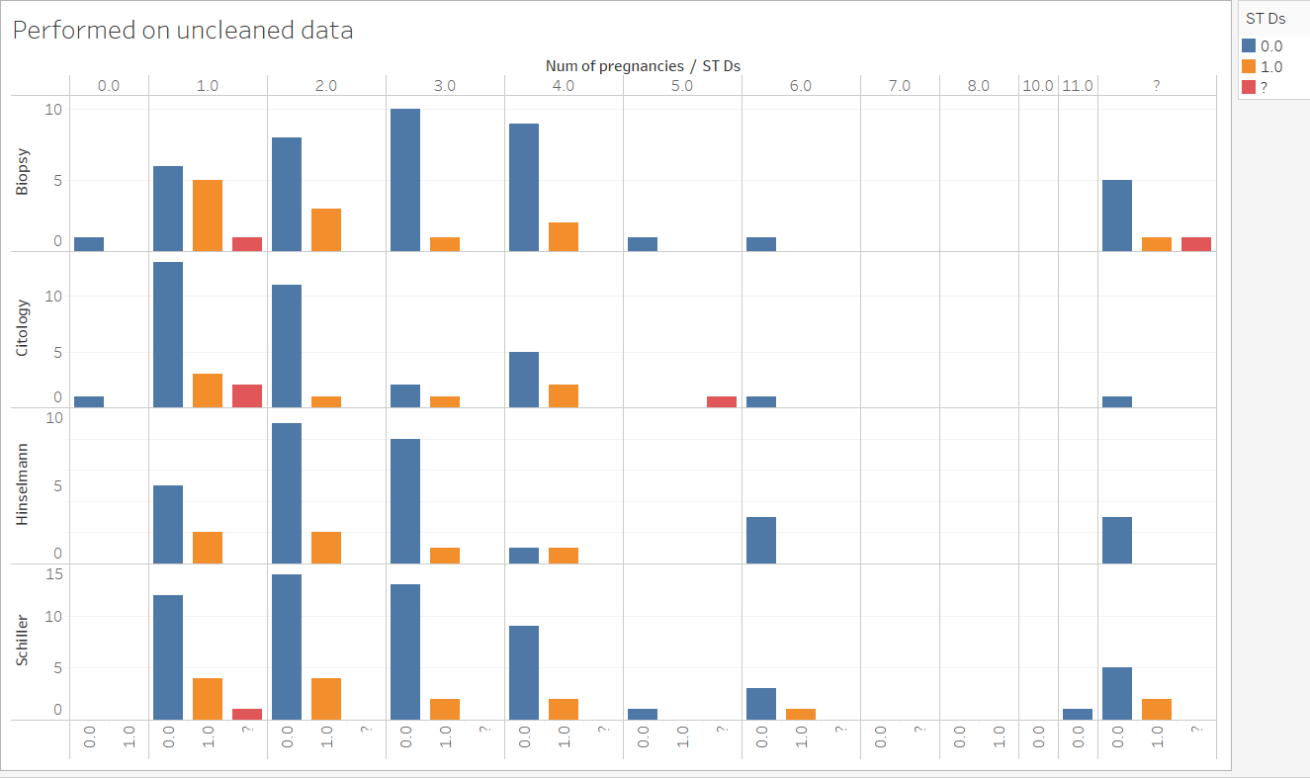
Data Exploration
Visualization to show the pattern of missing values in the dataset.

Slide 6

Data Pre-processing
Removed rows with most of the features having missing values(105 rows)
Removed columns
STDs
STDs (number)
STDs: Number of diagnosis
STDs: Time since first diagnosis
STDs: Time since last diagnosis
Data Imputation for the missing values
Calculated median for columns and replaced them with missing values. For categorical variables, it's like replacing them with max count of 0 or 1.
Over Sampling done on 1s

Slide 7
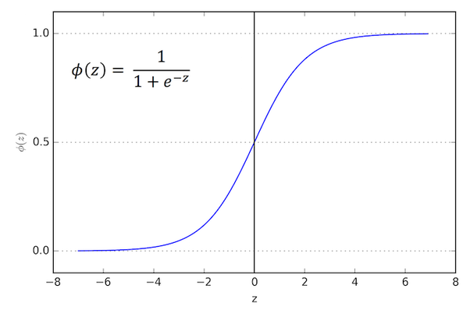
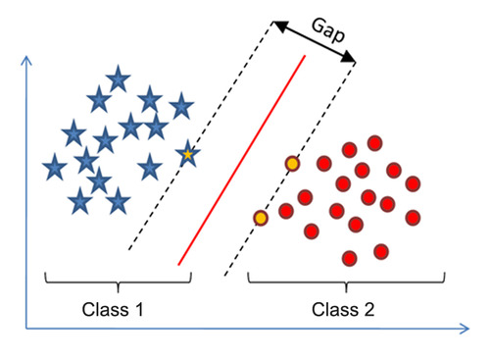
Algorithms Used
Type of problem Classification
Following Machine Learning algorithms were considered:
Logistic Regression
Support Vector Machines
Notes:
SVM is one of the most robust and accurate algorithm among the other classification algorithms.

Slide 8
Method 1: Logistic Regression
Logistic regression is the appropriate regression analysis to conduct when the dependent variable is dichotomous (binary).
Like all regression analyses, the logistic regression is a predictive analysis.
> logit.reg <- glm(Schiller ~ ., data = Cerv_sub_Schiller_over, family = "binomial")

Slide 9
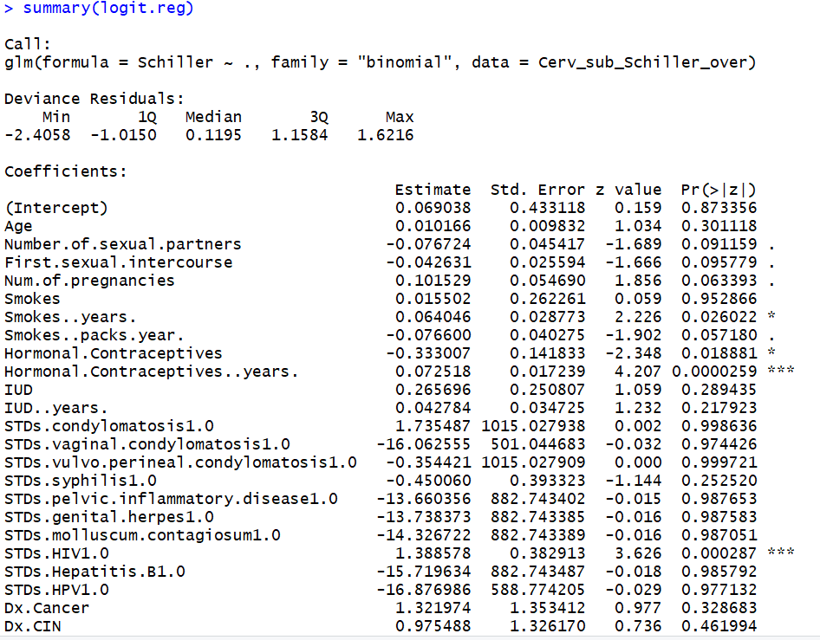
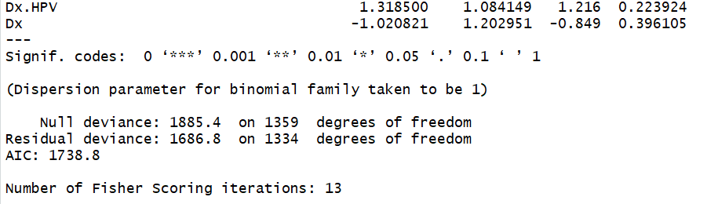

Slide 10
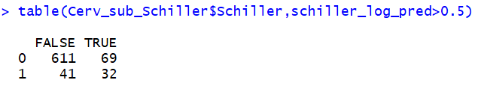
Confusion Matrix

Slide 11
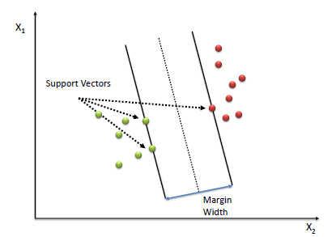
Method 2: SVM
A Support Vector Machine (SVM) performs classification by finding the hyperplane that maximizes the margin between the two classes.
The vectors (cases) that define the hyperplane are the support vectors.

Slide 12
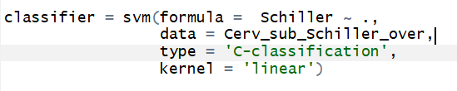
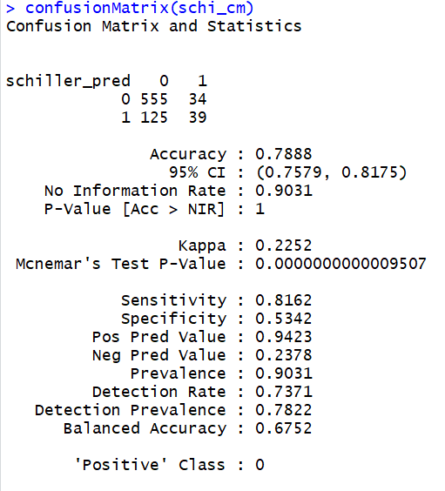

Slide 13

Results
 | Hinselmann | Schiller | Citology | Biopsy
Logistic Regression | 85.12% | 85.52% | 89.90% | 86.05%
SVM | 67.46% | 79.02% | 64.54% | 66.40%

Slide 14
Future works
More Classification models can be applied
More data can be collected
Current models can be further tuned up to increase accuracy
Use of under-sampling to 0s, or both under-sampling of 0s and over-sampling of 1s

Slide 15
References
Dataset- https://archive.ics.uci.edu/ml/datasets/Cervical+cancer+%28Risk+Factors%29
Textbook - DATA MINING FOR BUSINESS ANALYTICS
Concepts, Techniques, and Applications in R

Slide 16
Conclusion
Achieved a good 89% accuracy with Citology outcome when Logistic Regression was used.
Able to get this after removing few columns and removing samples with missing values.
We can conclude that Logistic Regression is better for this problem compared to SVM in terms of accuracy.
Thanks for bearing us!

